Slide 1
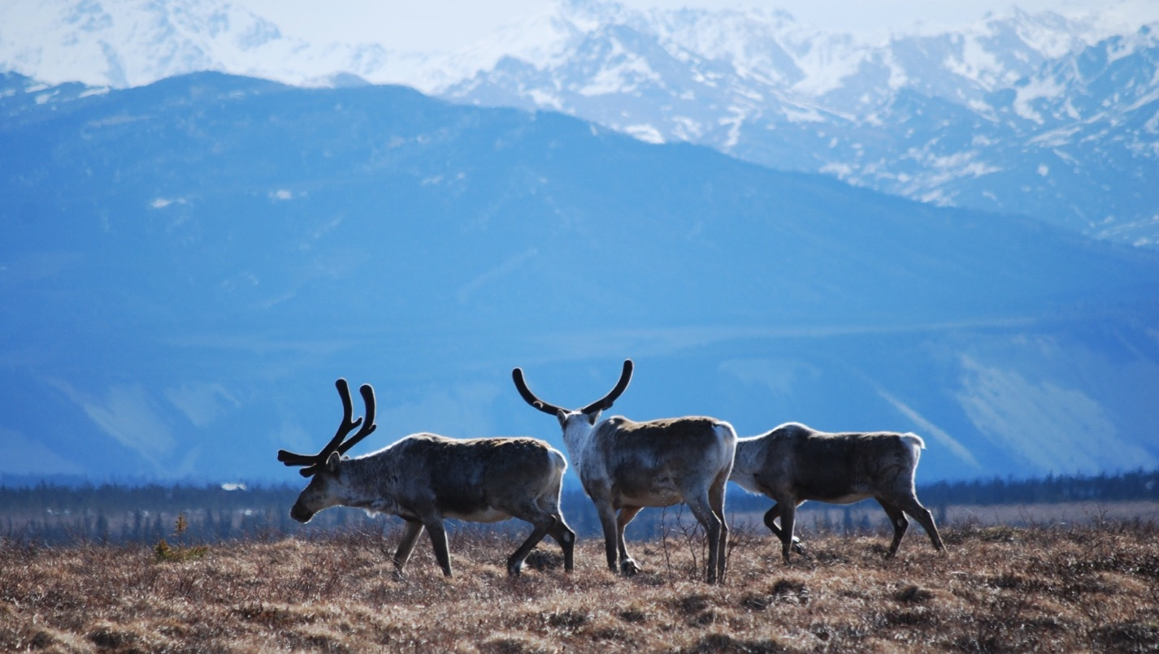
Arctic Boreal Vulnerability Experiment (ABoVE)
2019 ABoVE Airborne Flights
2 July 2019 (DOY 183)
AVIRIS-NG: Mackenzie Delta, Herschel Island
Charles Miller, Deputy Science Lead
Jet Propulsion Laboratory, California Institute of Technology
and the ABoVE Science Team For Hank Margolis, Mike Falkowski, Bruce Tagg, Jack Kaye
NASA HQ
2019

Slide 2
2 July 2019/DOY 183 Mackenzie Delta, Herschel Island
Daily Status:
AVIRIS-NG / Dynamic Aviation B-200 (N53W)
REPORT DATE: 2 July 2019
Current Status of Aircraft: GREEN
Current Status of AVIRIS: GREEN
Current Deployment Location: Fairbanks AK (PAFA)
Crew: S Wilson (PIC), C McCann, M Eastwood, L Rios, C Miller
Science Planning: A Thorpe
Data Processing: W Olsen-Duvall
Instrument Manager: M Eastwood
Instrument PI: R Green
Science Lead: C Miller

Slide 3
2 July 2019/DOY 183 Mackenzie Delta, Herschel Island
Daily Summary:
Leg 1: Mackenzie Delta – Herschel Island – Deadhorse (refuel)
Leg 2: Deadhorse - Fairbanks
Forecast for a high pressure cell and clear skies over the Mackenzie Delta. Arrived to find clouds moving in; collected partial lines near the coast and channel
Took advantage of unexpected clear skies to map Herschel Island on transit to refuel at Deadhorse (moderate cirrus overhead)

Slide 4
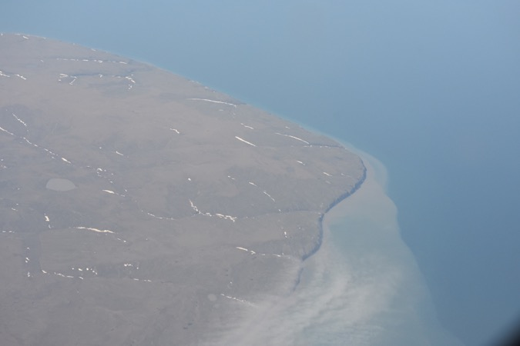
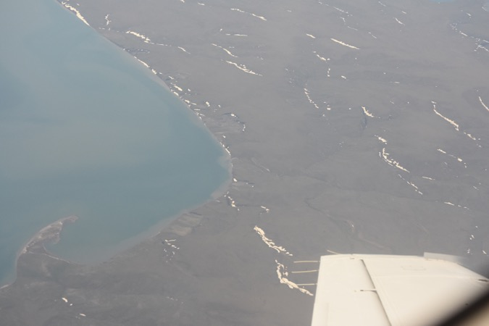
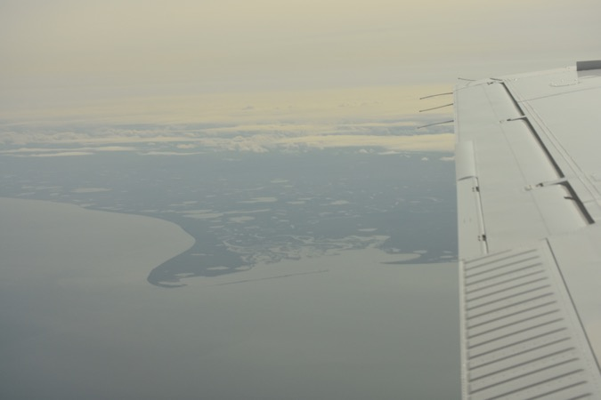
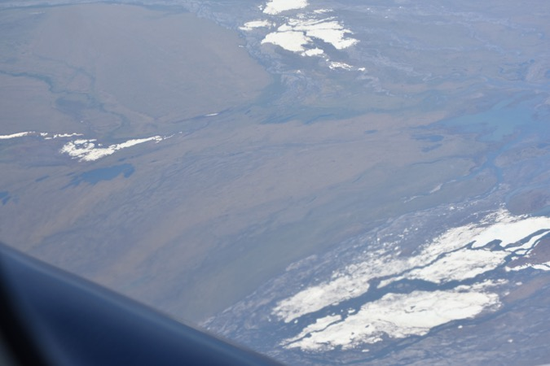
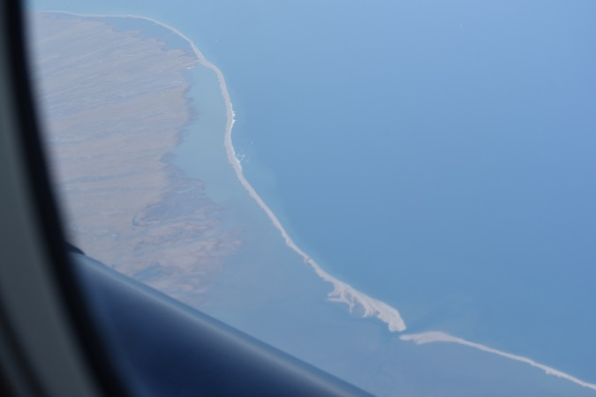
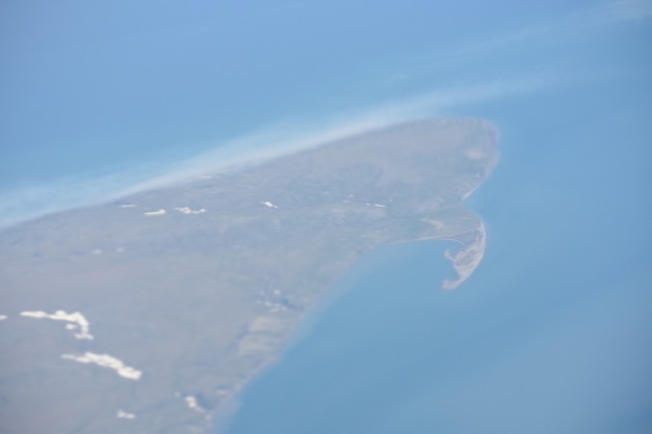
2 July 2019/DOY 183 Mackenzie Delta, Herschel Island
Herschel Island

Slide 5
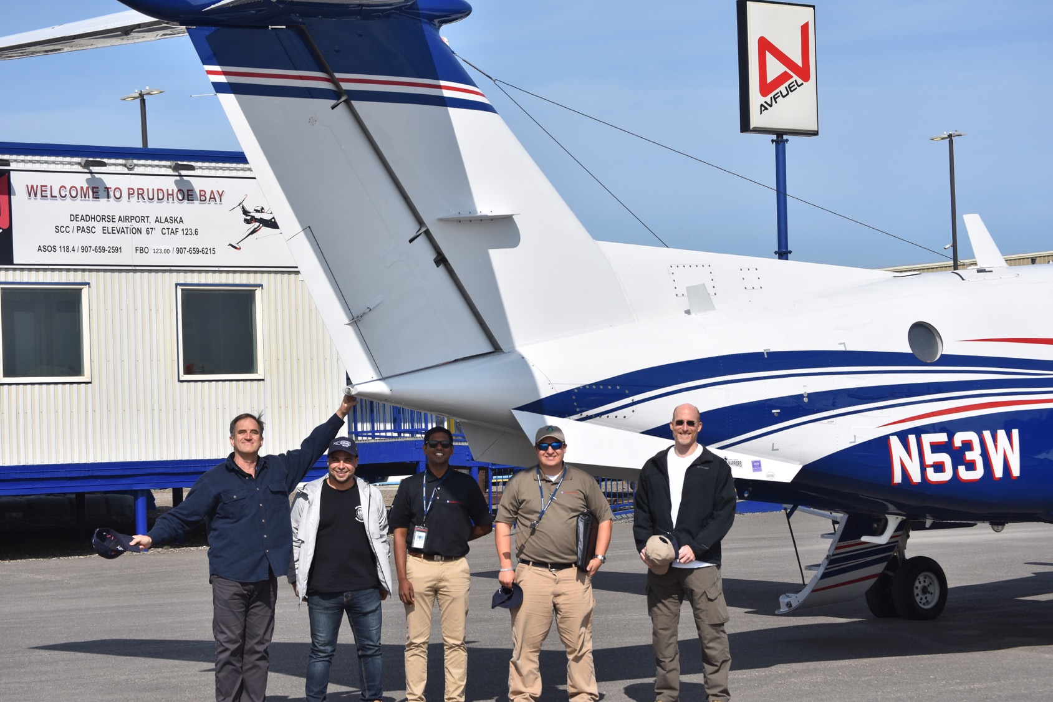

Slide 6
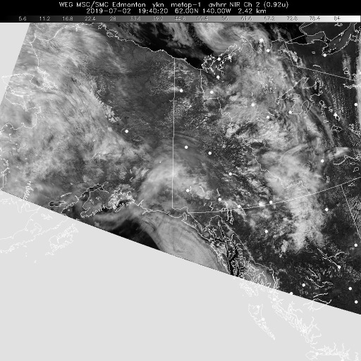
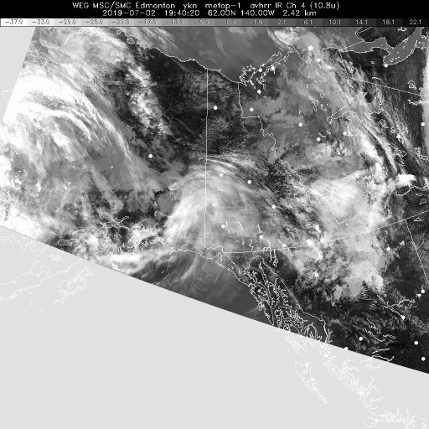
2 July 2019/DOY 183 Mackenzie Delta, Herschel Island
Vis 1940Z
IR 1940Z
Satellite imagery shows forecasted high pressure cell west of the Mackenzie Delta
Good conditions over Herschel Island

Slide 7
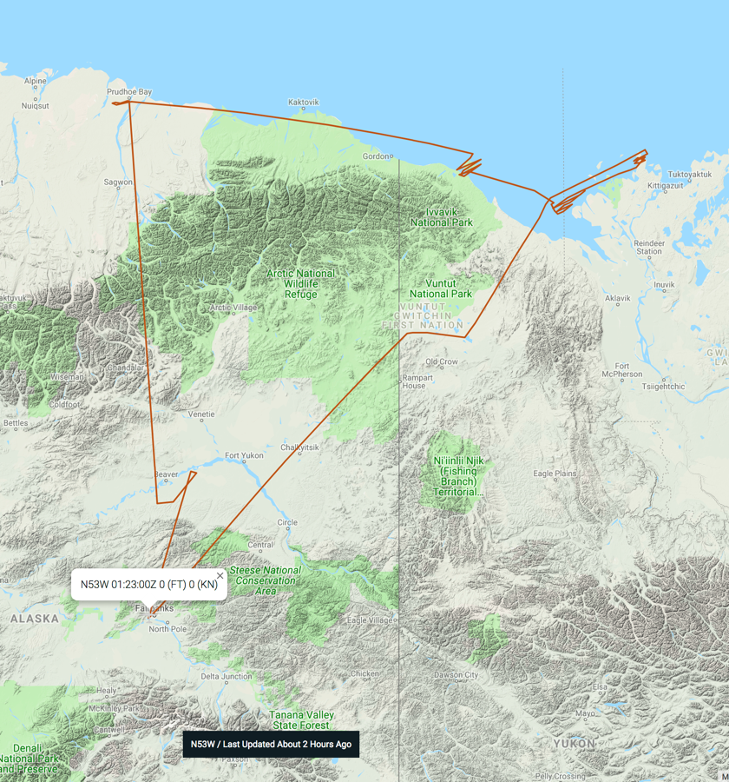
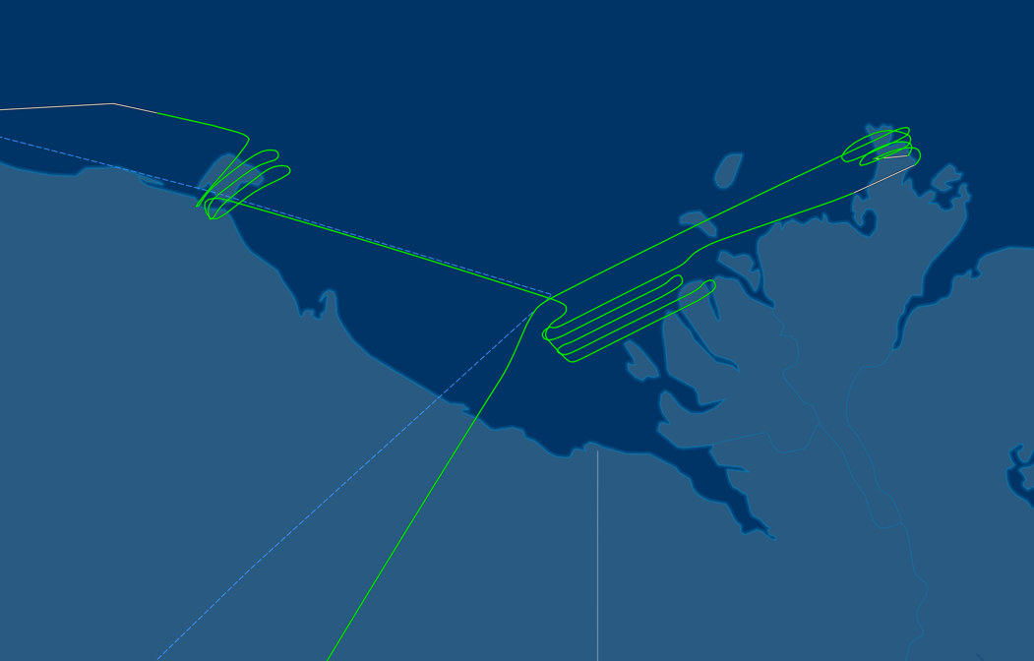
2 July 2019/DOY 183 Mackenzie Delta, Herschel Island
Herschel Island
Mackenzie
Delta
As-Flown Lines

Slide 8
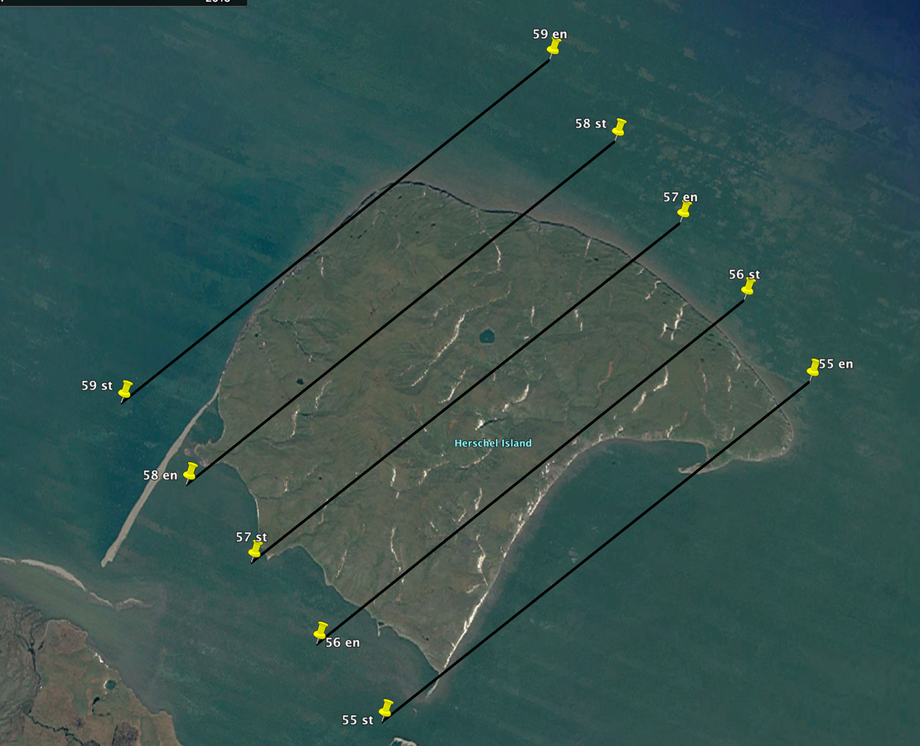
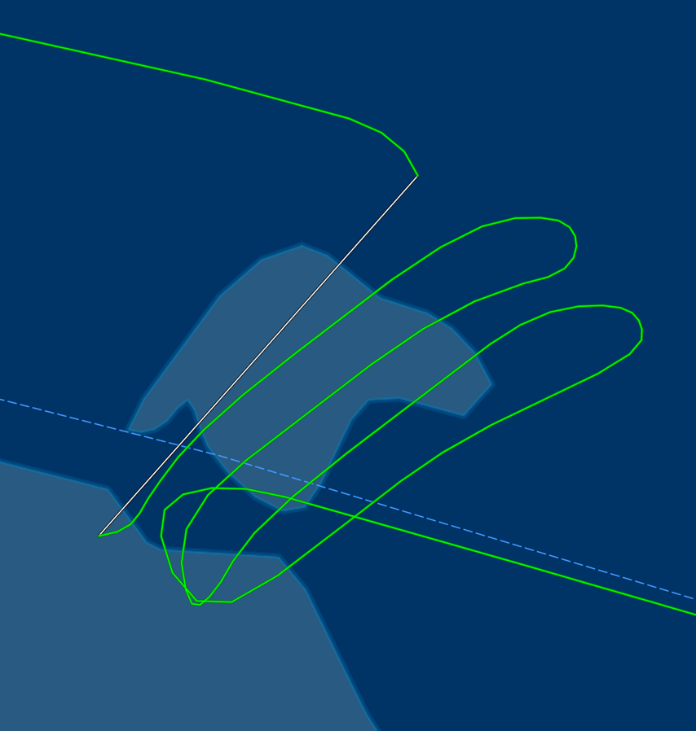
2 July 2019/DOY 183 Mackenzie Delta, Herschel Island
Herschel Island
Planned Lines
Herschel Island
As-Flown Lines

Slide 9
2 July 2019/DOY 183 Mackenzie Delta, Herschel Island
AVIRIS-NG Quick-look products
https://avirisng.jpl.nasa.gov/cgi/flights.cgi?step=view_flightlog&flight_id=ang20190702t
A. Line AVng_313A-313Z_FL184 , ang20190702t183411_geo : Old Crow Flats
B. Line MackDelta_L030_FL175 , ang20190702t190508_geo : Mackenzie Delta grid reverse
A
B
A. Old Crow Flats acquisition of opportunity
B. Clouds coming in faster than forecast in Mackenzie Delta
Notes:
7/19/19 review
Yellow, 10% cloud cover
RED - reacquire

Slide 10
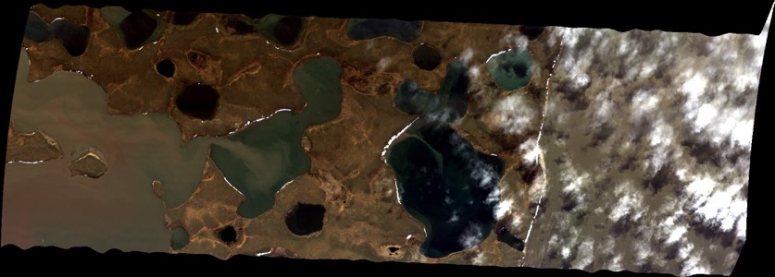
2 July 2019/DOY 183 Mackenzie Delta, Herschel Island
AVIRIS-NG Quick-look products
https://avirisng.jpl.nasa.gov/cgi/flights.cgi?step=view_flightlog&flight_id=ang20190702t
A. Line MackDelta_L029_FL175 , ang20190702t192442_geo : Mackenzie Delta grid
B. Line MackDelta_L028_FL175 , ang20190702t193226_geo : Mackenzie Delta grid
A
B
A. Cloud deck over the channel
B. Cloud deck over the channel
Notes:
7/19/19 Review
50% usable, clouds over channel; acquisition stopped after 10% of line
50% usable, clouds over channel; acquisition stopped after 10% of line

Slide 11
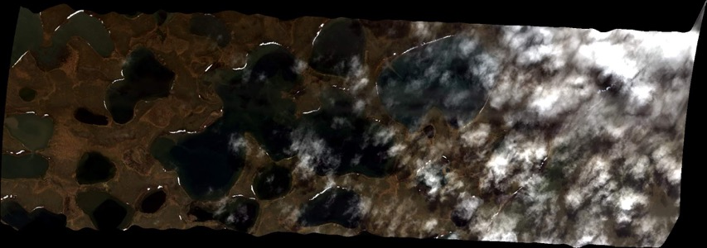
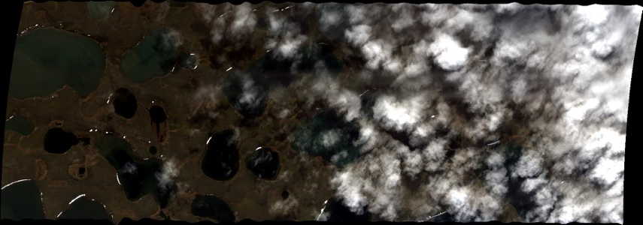
2 July 2019/DOY 183 Mackenzie Delta, Herschel Island
AVIRIS-NG Quick-look products
https://avirisng.jpl.nasa.gov/cgi/flights.cgi?step=view_flightlog&flight_id=ang20190702t
A. Line MackDelta_L027_FL175 , ang20190702t193826_geo : Mackenzie Delta grid
B. Line MackDelta_L026_FL175 , ang20190702t194452_geo : Mackenzie Delta grid
A
B
A. Cloud deck over the channel
B. Cloud deck over the channel
Notes:
7/19/19 Review
RED. 70% cloud cover, 30% usable; aborted after ~10% of line
RED. 70% cloud cover, 30% usable; aborted after ~10% of line

Slide 12
2 July 2019/DOY 183 Mackenzie Delta, Herschel Island
AVIRIS-NG Quick-look products
https://avirisng.jpl.nasa.gov/cgi/flights.cgi?step=view_flightlog&flight_id=ang20190702t
A. Line MackDelta_L027_FL175 , ang20190702t195609_geo : Mackenzie Delta grid
B. Line MackDelta_L026_FL175 , ang20190702t200420_geo : Mackenzie Delta grid
A
B
A. Acquisition stopped when clouds encountered; other end of the line
B. Acquisition stopped when clouds encountered; other end of the line
Notes:
7/19/19 Review
Clouds over first 20% of acquisition; good data over water
Clouds over first 10% of acquisition; good data over water

Slide 13
2 July 2019/DOY 183 Mackenzie Delta, Herschel Island
AVIRIS-NG Quick-look products
https://avirisng.jpl.nasa.gov/cgi/flights.cgi?step=view_flightlog&flight_id=ang20190702t
A. Line MackDelta_L025_FL175 , ang20190702t201130_geo : Mackenzie Delta grid
B. Line MackDelta_L024_FL175 , ang20190702t201841_geo : Mackenzie Delta grid
A
B
A. Acquisition stopped when clouds encountered; sampling over the main channel
B. Acquisition stopped when clouds encountered; sampling over the main channel

Slide 14
2 July 2019/DOY 183 Mackenzie Delta, Herschel Island
AVIRIS-NG Quick-look products
https://avirisng.jpl.nasa.gov/cgi/flights.cgi?step=view_flightlog&flight_id=ang20190702t
A. Line MackDelta_L023_FL175 , ang20190702t202659_geo : Mackenzie Delta grid
A
B
A. Acquisition stopped when clouds encountered; sampling over the main channel

Slide 15
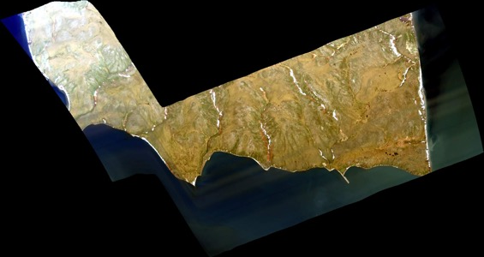
2 July 2019/DOY 183 Mackenzie Delta, Herschel Island
AVIRIS-NG Quick-look products
https://avirisng.jpl.nasa.gov/cgi/flights.cgi?step=view_flightlog&flight_id=ang20190702t
A. Line Herschal Island_0 , ang20190702t205318_geo : Herschel Island grid
B. Line HershIsland_L001_FL177 , ang20190702t205702_geo : Herschel Island grid
A
B
A. Nice image, orthorectification challenges
B. Covers Meyers-Smith primary sampling area
Notes:
7/19/19 Review
Yellow: Cirrus above according to log
Yellow: Cirrus above according to log

Slide 16
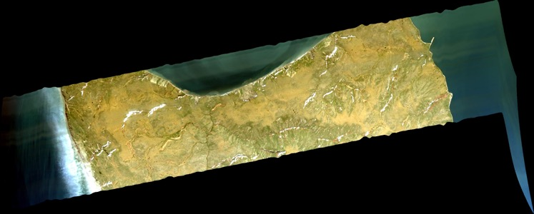
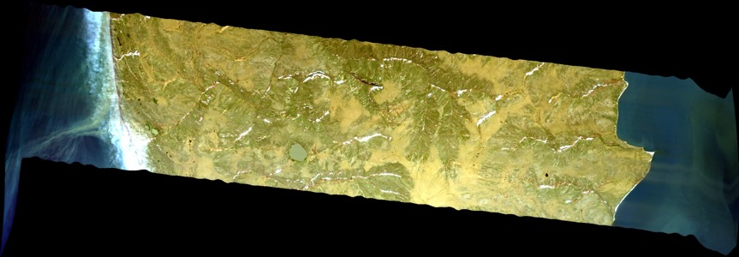
2 July 2019/DOY 183 Mackenzie Delta, Herschel Island
AVIRIS-NG Quick-look products
https://avirisng.jpl.nasa.gov/cgi/flights.cgi?step=view_flightlog&flight_id=ang20190702t
A. Line HershIsland_L002_FL177 , ang20190702t210208_geo : Herschel Island grid
B. Line HershIsland_L003_FL177 , ang20190702t210704_geo : Herschel Island grid
A
B
A. Some snow still seen on island?
B. Nice imagery of coastal erosion
Notes:
7/19/19 Review
Yellow: Cirrus above according to log
Yellow: Cirrus above according to log

Slide 17
2 July 2019/DOY 183 Mackenzie Delta, Herschel Island
AVIRIS-NG Quick-look products
https://avirisng.jpl.nasa.gov/cgi/flights.cgi?step=view_flightlog&flight_id=ang20190702t
A. Line HershIsland_L004_FL177 , ang20190702t211213_geo : Herschel Island grid
B. Line HershIsland_L005_FL177 , ang20190702t211725_geo : Herschel Island grid
A
B
A. Acquisition stopped when clouds encountered; sampling over the main channel
B. Acquisition stopped when clouds encountered; sampling over the main channel
Notes:
7/19/19 Review
Yellow: Cirrus above according to log
Yellow: Cirrus above according to log

Slide 18
2 July 2019/DOY 183 Mackenzie Delta, Herschel Island
AVIRIS-NG Quick-look products
https://avirisng.jpl.nasa.gov/cgi/flights.cgi?step=view_flightlog&flight_id=ang20190703t
A. Line AVng_321A-321B_FL178 , ang20190703t002744_geo : Herschel Island grid
A
B
A. Cloud interference
Notes:
Review 7/19/19
Unusable from quicklook

Slide 19
Backup

Slide 20
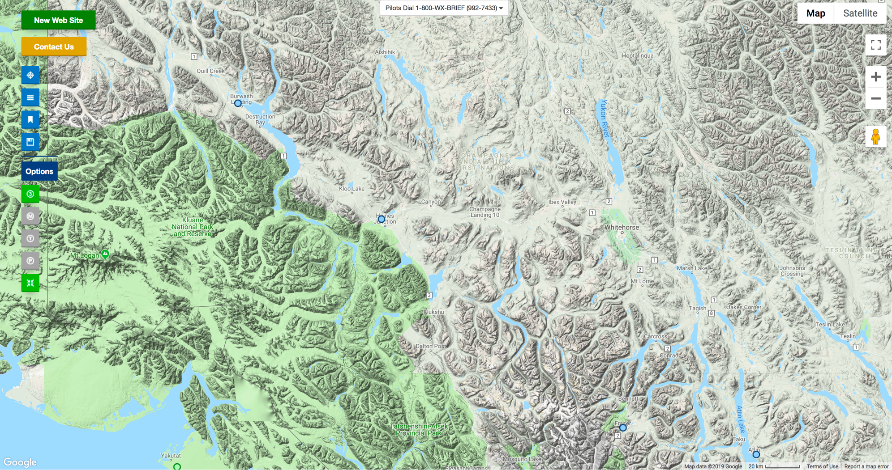
FAA Camera Locations

Slide 21
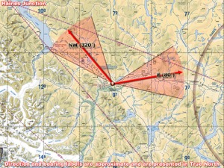
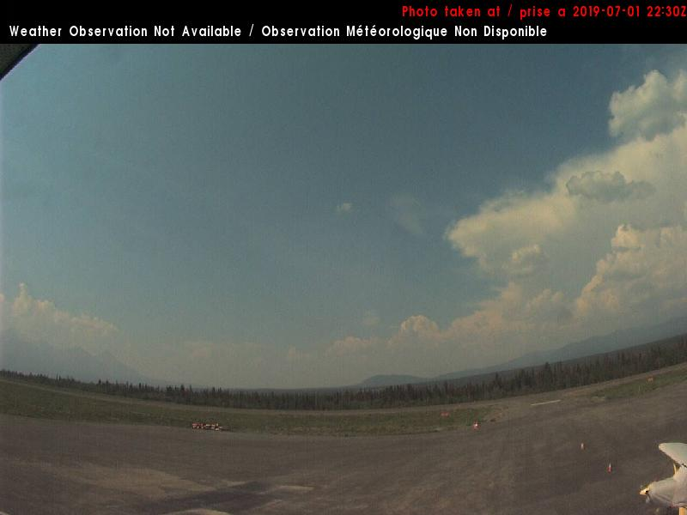
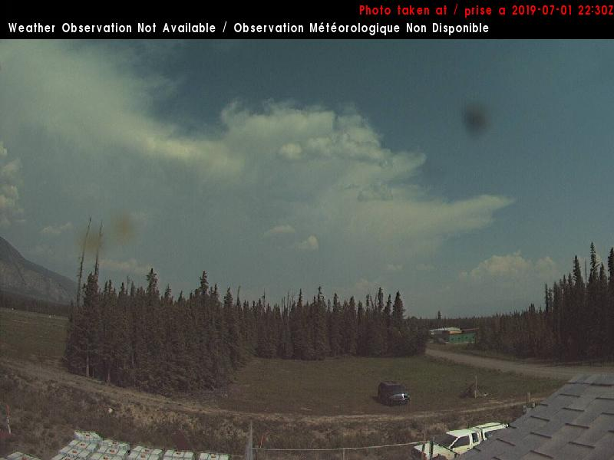
2 July 2019/DOY 183 Mackenzie Delta, Herschel Island
Haines Junction YT – 1440 AKDT/2240 UTC
Northwest
East

Slide 22
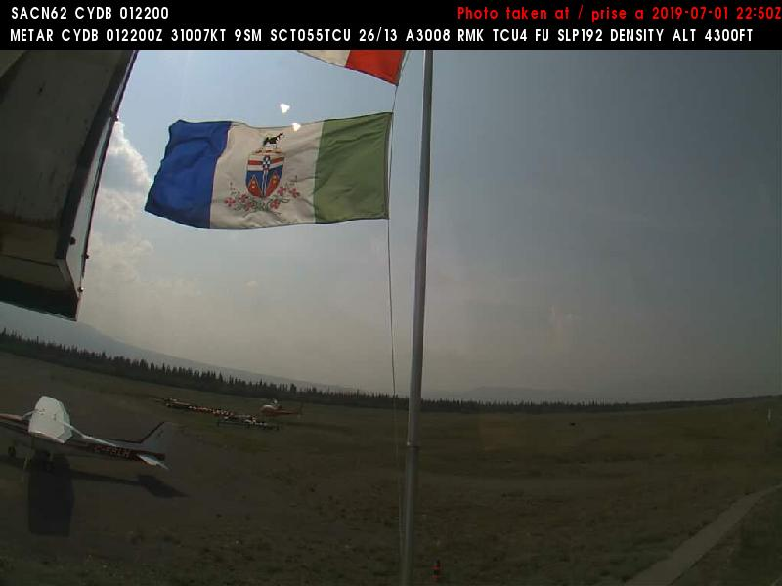
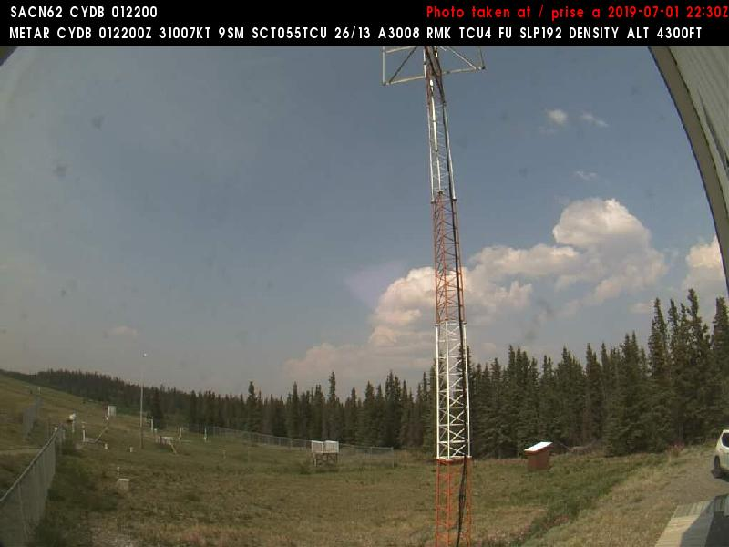
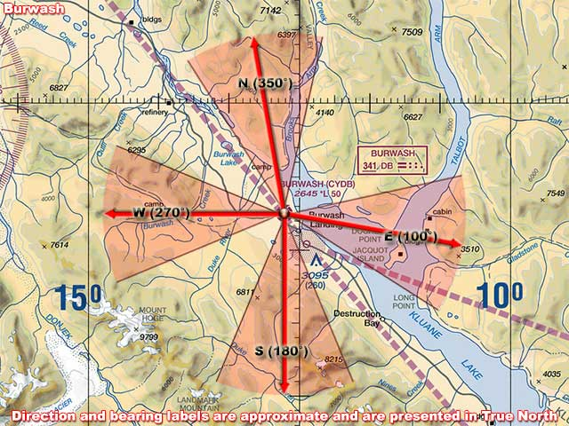
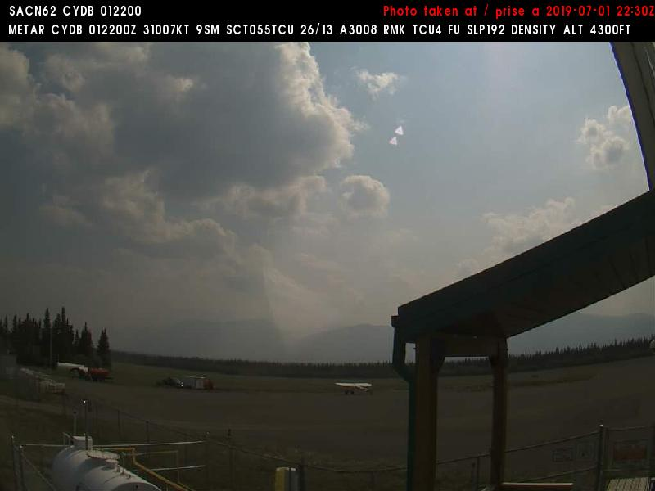
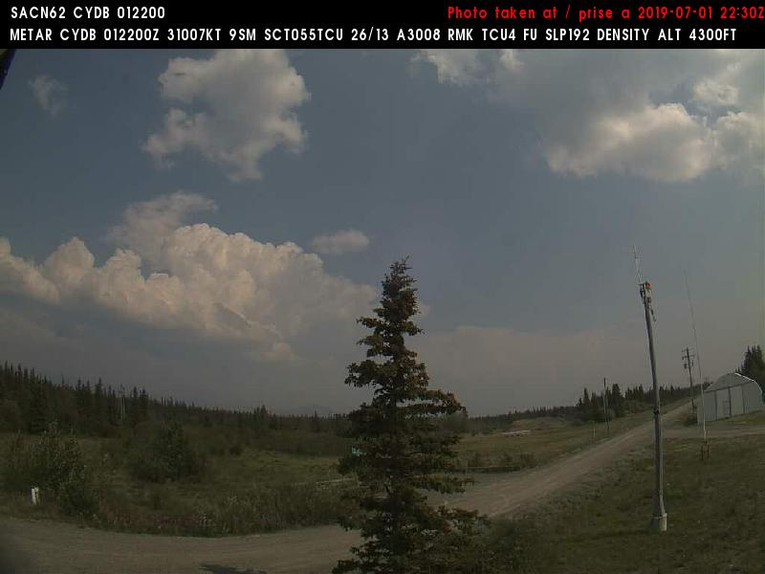
2 July 2019/DOY 183 Mackenzie Delta, Herschel Island
Burwash YT – 1310 AKDT/2110 UTC

